Slide 1



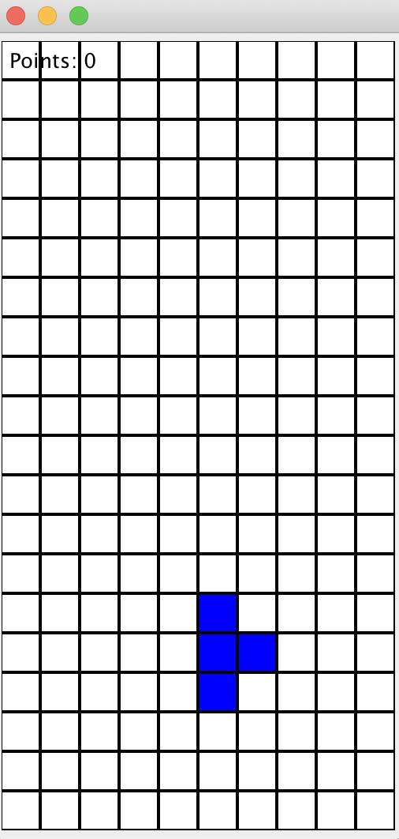
TETRIS GAME
Group 6 Khanh Phan, Shaista Usman, Yi Niu

Slide 2
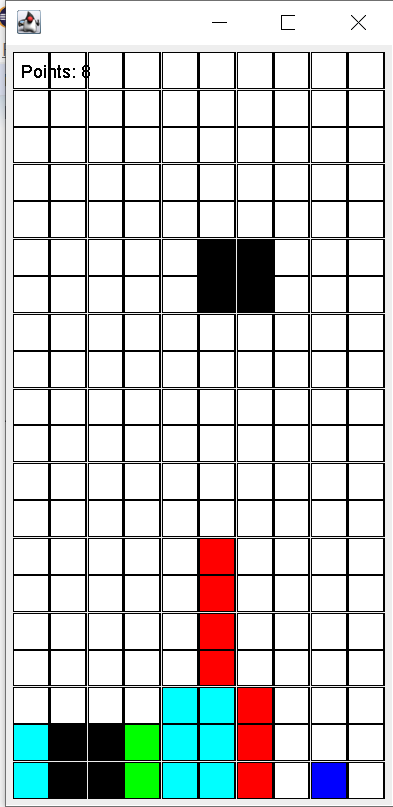
TETRIS GAME

Slide 3
Junit Tests

Slide 4
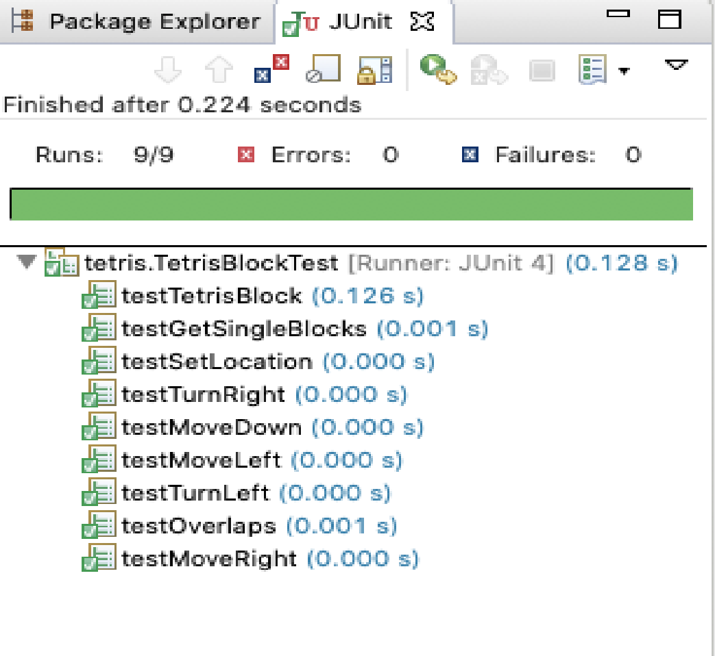
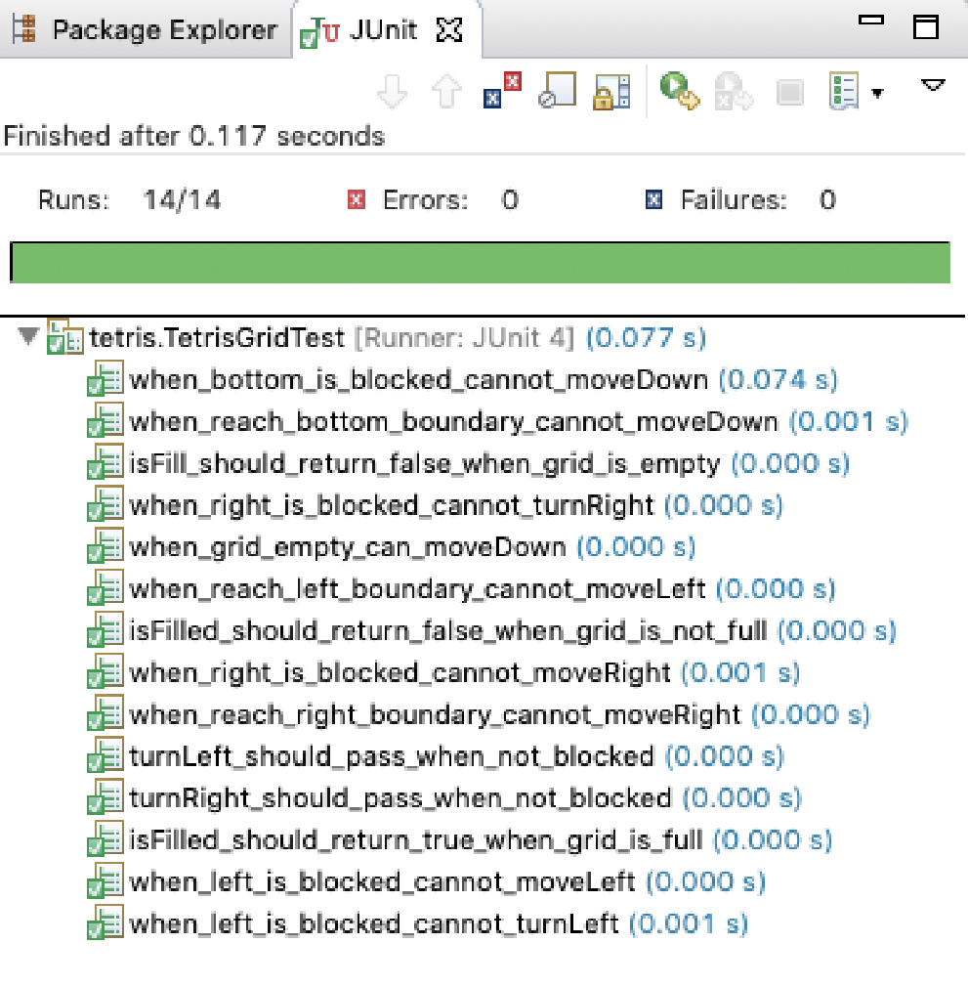
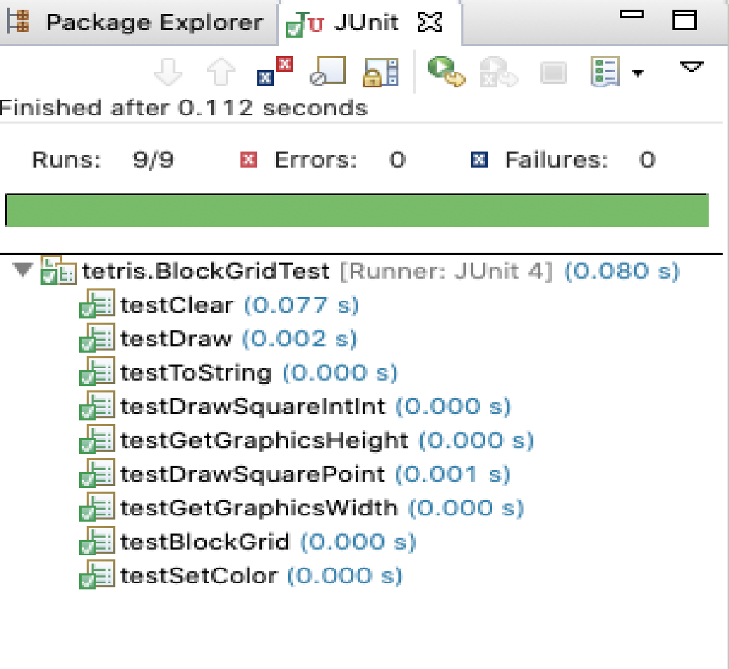

Slide 5

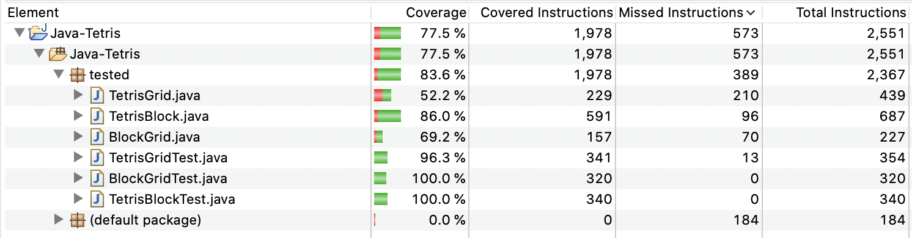
Code Coverage Analysis

Slide 6
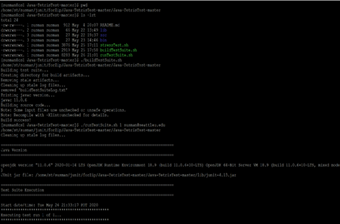
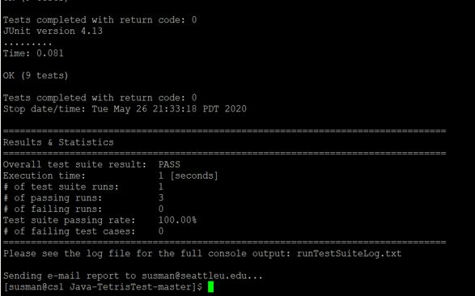
Building the Test Suite and Automating the Test Run

Slide 7
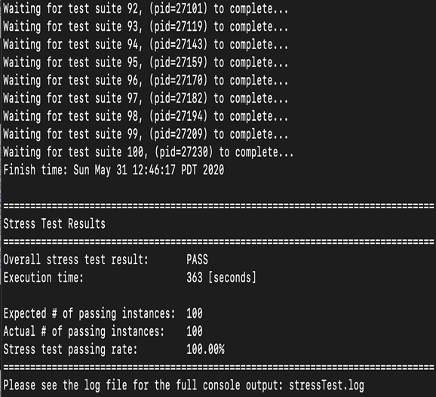
Stress Testing

Slide 8
Thank You!

